Slide 1
Motorway Expansion Project (2024)
Environmental Impact Assessment and Mitigation Measures
GROUP 2

Slide 2
Introduction
Environmental Impact Assessment (EIA) evaluates potential project effects, aiming for sustainability and informing decision-makers about environmental impacts and mitigation measures.
This assessment is for the road expansion project from the Accra Mall to the Tema Motorway Roundabout.

Slide 3
ENVIRONMENTAL IMPACTS
Climate change impacts
Greenhouse gas emissions from construction activities and increased vehicle traffic contribute to climate change.
Soil and water contamination
Potential contamination of soil and water from spills of construction materials and chemicals.
Air pollution
Emissions from construction machinery and increased traffic can lead to air pollution, affecting air quality and public health.

Slide 4
ENVIRONMENTAL IMPACTS
Noise pollution
Construction noise and increased traffic noise can disturb wildlife and nearby residents.
Visual impacts
Alteration of the visual landscape due to construction of infrastructure and changes in land use.
Loss of biodiversity
Destruction of habitat may result in the loss of plant and animal species.

Slide 5
MITIGATION MEASURES
Climate change impacts:
Implement measures to reduce greenhouse gas emissions, such as promoting public transportation and encouraging energy-efficient construction practices.
Incorporate climate change adaptation strategies into design and construction plans to enhance resilience to climate-related hazards.
Soil and water contamination
Implement spill prevention and response plans to minimize the risk of soil and water contamination during construction.
Properly dispose of construction materials and chemicals to prevent pollution of soil and water resources.
Air pollution:
Require the use of low-emission construction machinery and equipment.
Implement dust control measures, such as watering down construction sites and using dust suppression technologies.

Slide 6
MITIGATION MEASURES
Visual impacts and waste management
Install screening barriers around the worksite.
Implement strict waste management to prevent debris accumulation.
Noise pollution:
Implement noise barriers and sound walls along the motorway to mitigate noise impacts on nearby residents and wildlife.
Schedule construction activities during off-peak hours to minimize noise disturbances.
Loss of biodiversity
Implement habitat enhancement measures, such as planting native vegetation and creating artificial habitat structures.
Monitor biodiversity before, during, and after construction to assess the effectiveness of mitigation measures.

Slide 7
MONITORING MEASURES
Establish regular environmental monitoring programs to track key indicators such as water and air quality, noise levels, and biodiversity.
Conduct construction site inspections to ensure compliance with environmental regulations and management plans.
Implement measures to prevent or minimize environmental impacts, such as erosion control, pollution prevention, and habitat restoration.
Engage with local communities and stakeholders to gather feedback and address environmental concerns promptly.
Develop contingency plans to address unforeseen environmental issues that may arise during construction.
Continuously evaluate and adapt environmental management strategies based on monitoring data and feedback from stakeholders.
Implement post-construction monitoring programs to assess the long-term environmental impacts of the project and ensure ongoing compliance with regulatory requirements.

Slide 8
FINDINGS ON RIGHT OF WAY

Slide 9
1000 feet Right Of Way
The total land area that would be affected by the proposed project of road expansion into ten lanes would affect a total of 403.3143317 acres comprising of both industrial and domestic buildings.

Slide 10
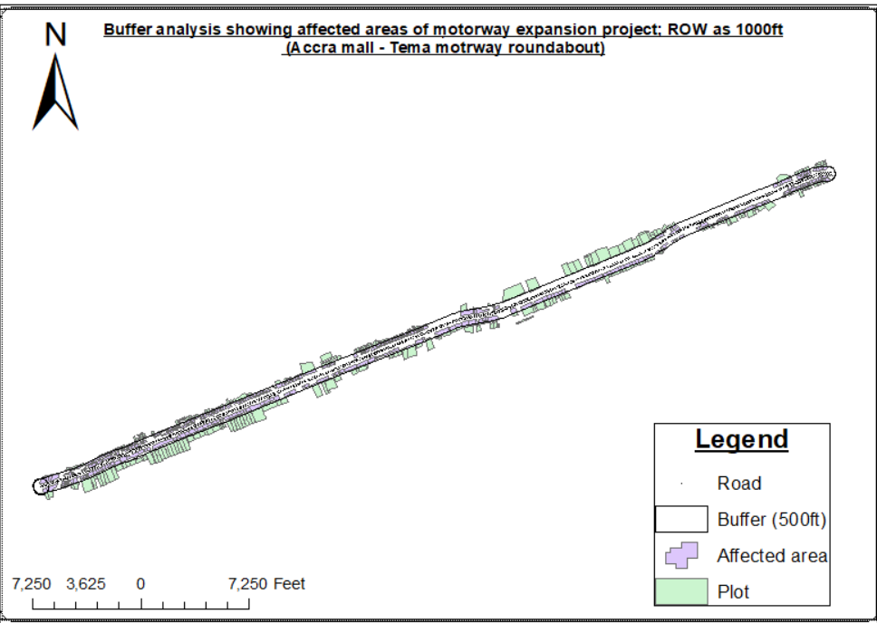
Link to map

Slide 11
600 feet Right Of Way
The recommended right of way that would be effective to implement in order to reduce economic and environmental costs is about 600 feet, which is about twice of the 90 meters allocation set by the Ghana Highways Authority.
After applying the 600 feet ROW, the areas affected are reduced to 127.4121781 acres

Slide 12
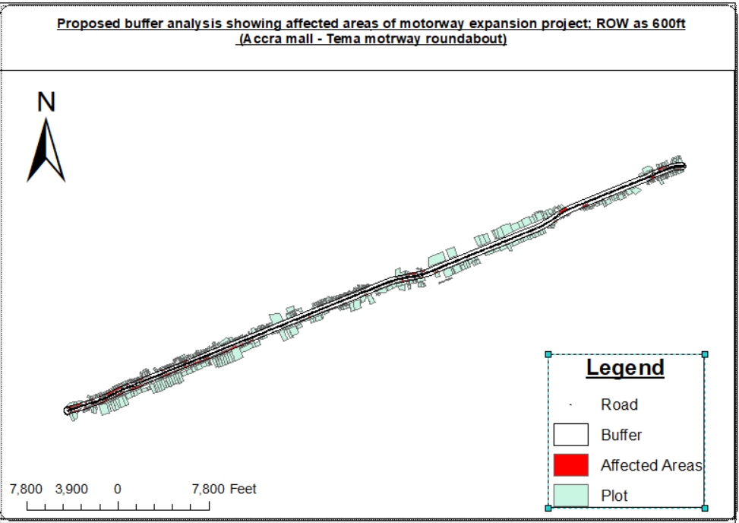
Link to map

Slide 13
THANK YOU

